Slide 1







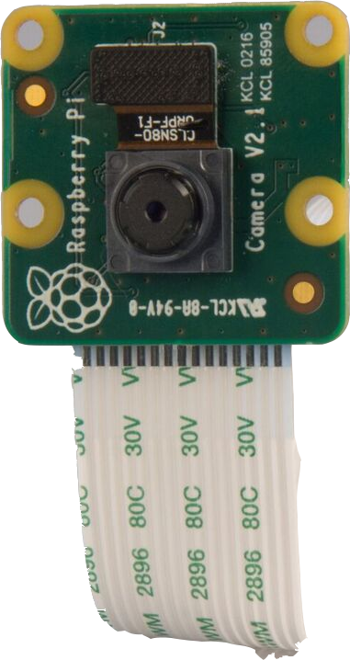



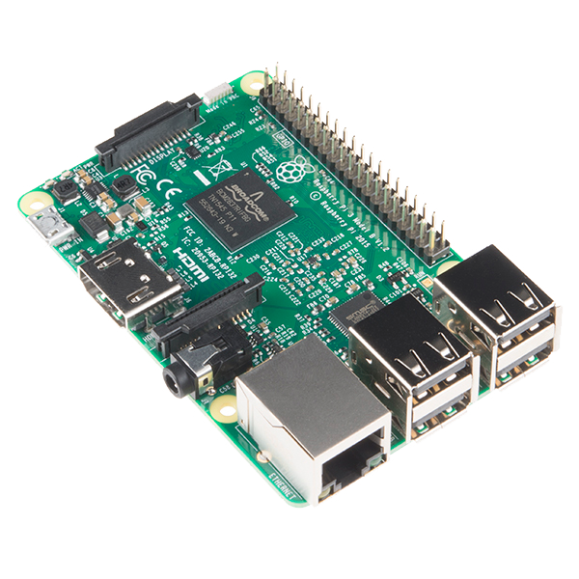

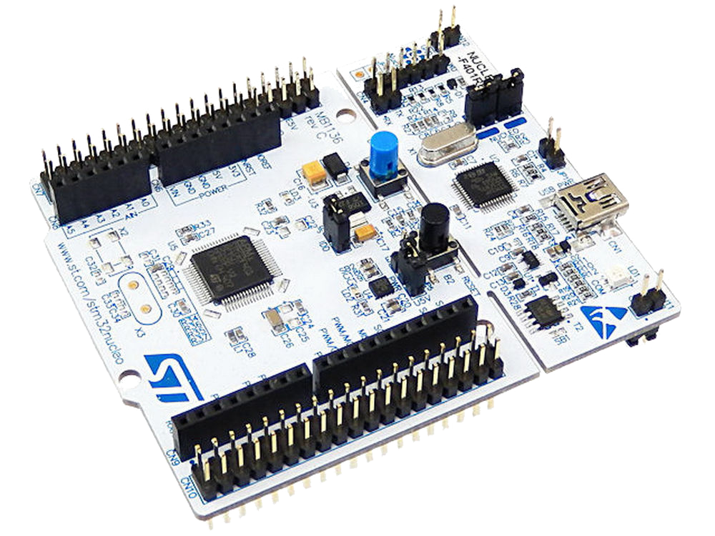

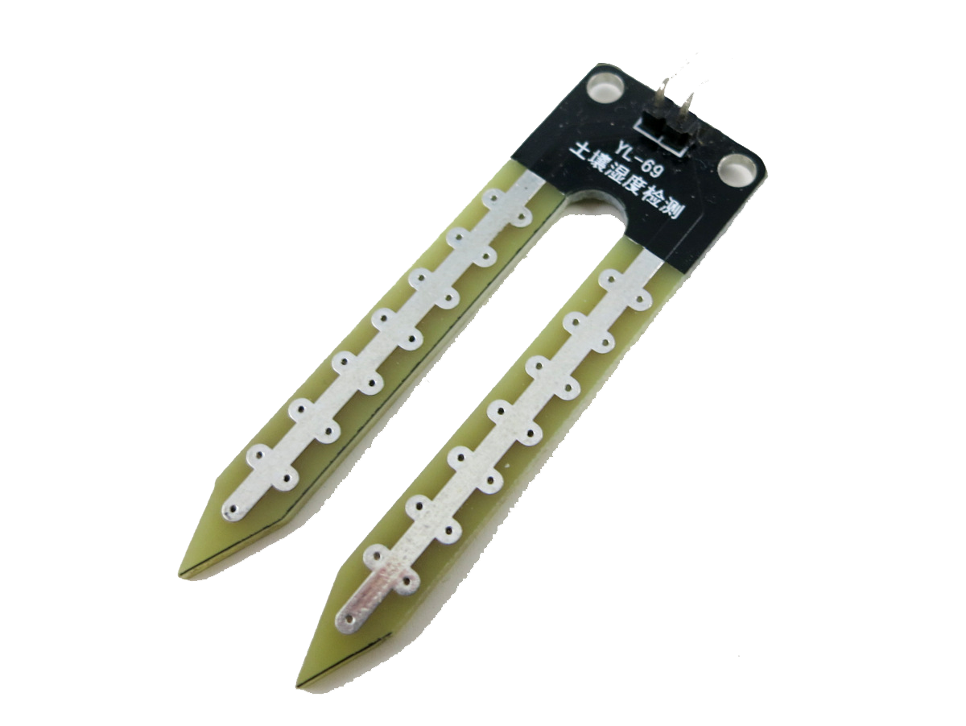






Hoykhom
King Mongkut's Institute of Technology Ladkrabang

Slide 2






Slide 3

Push and reply

Slide 4


Data Analytics

Slide 5
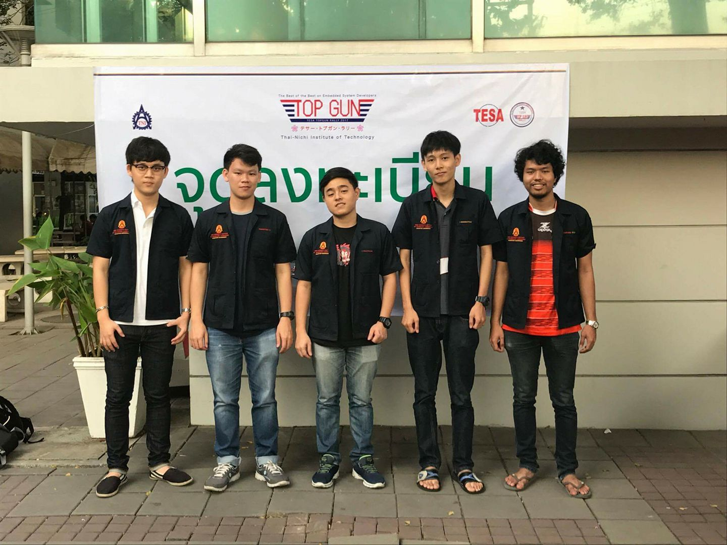
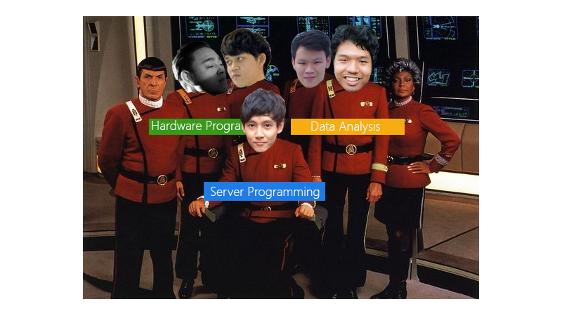
Teamworks!

Slide 6
Teamworks! (1)

Slide 7
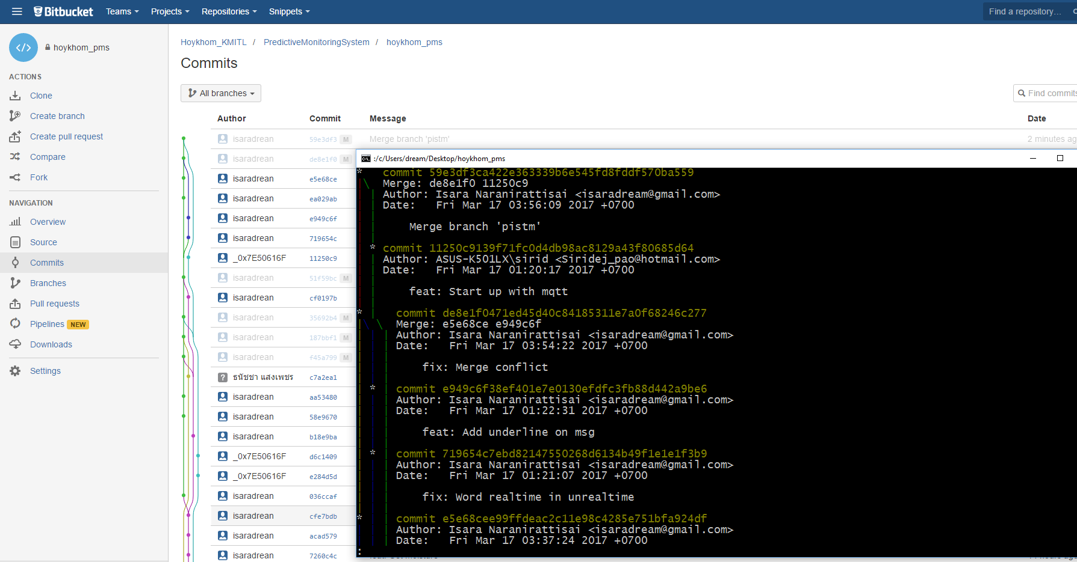
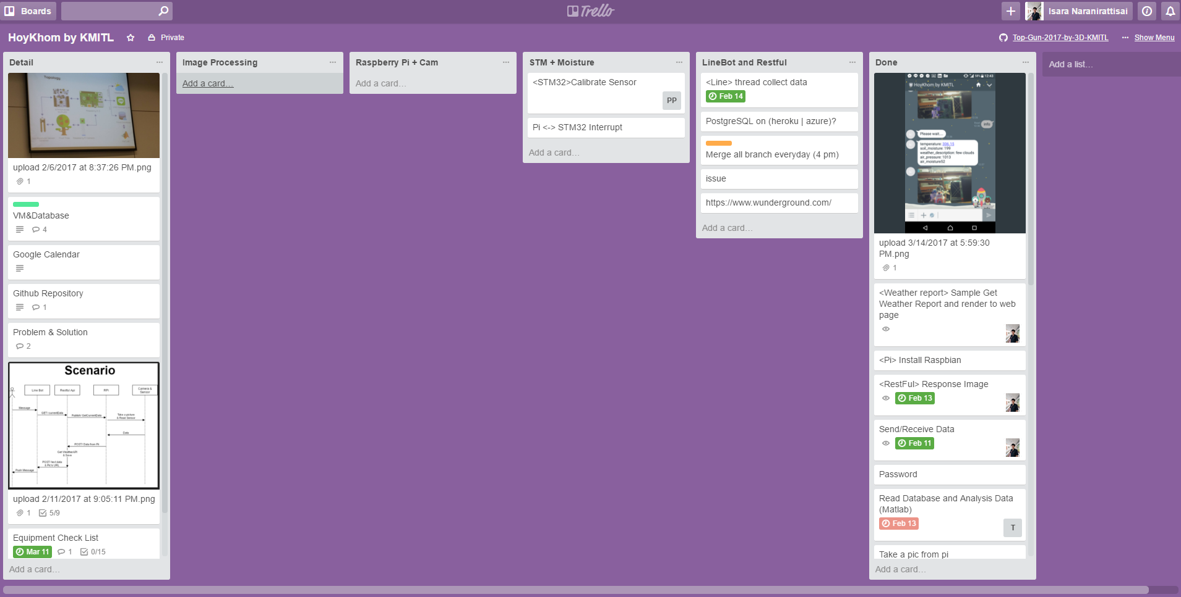
GIT <Bitbucket>

Slide 8
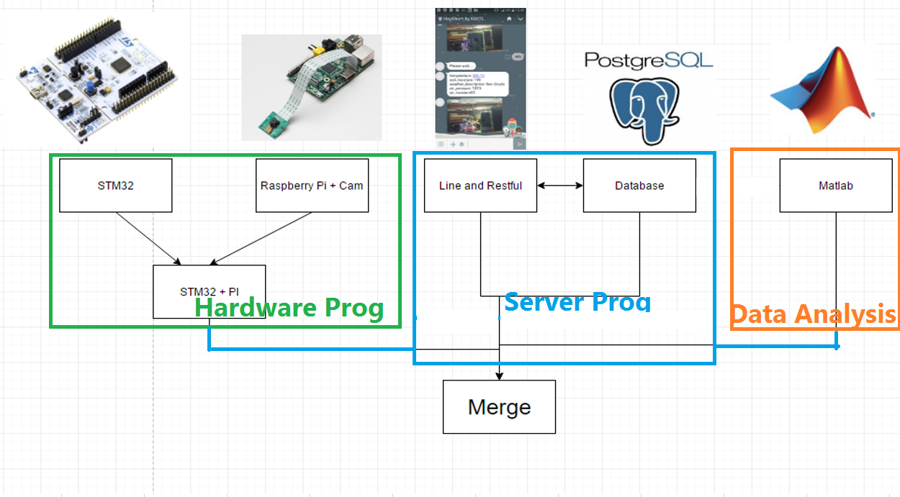
System Integration Strategy

Slide 9
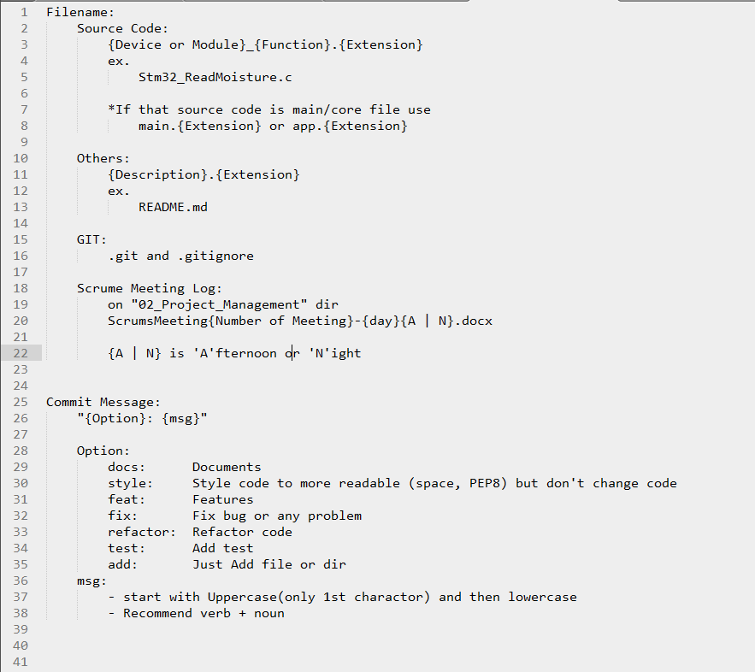
Naming Rules

Slide 10
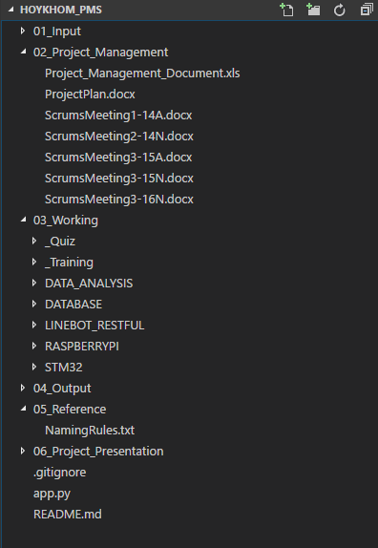
Directory Structure

Slide 11
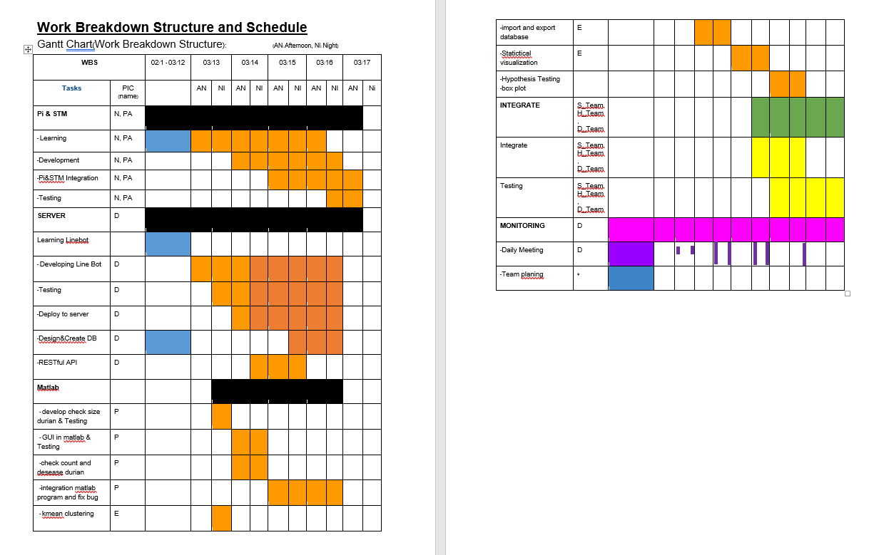
Working Breakdown Structure

Slide 12
Before the competition

Slide 13
Because It’s our 1st time for TESA Top Gun Rally…

Slide 14
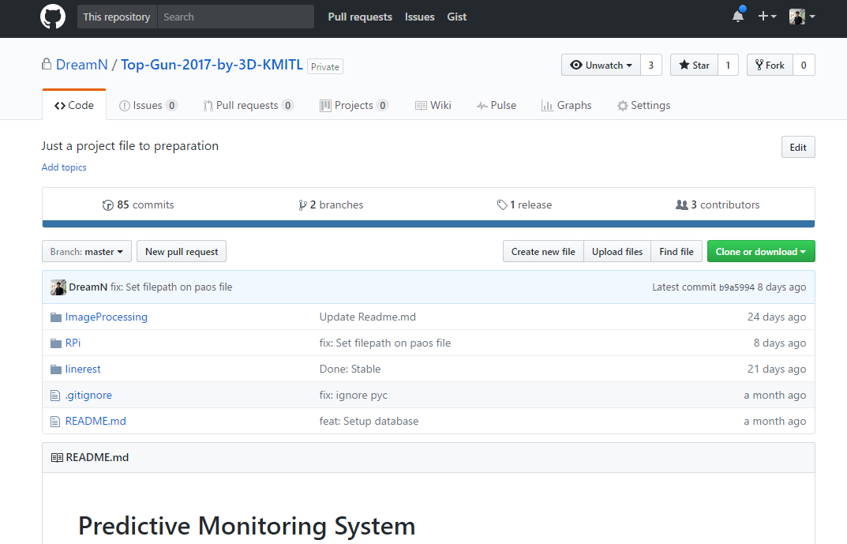
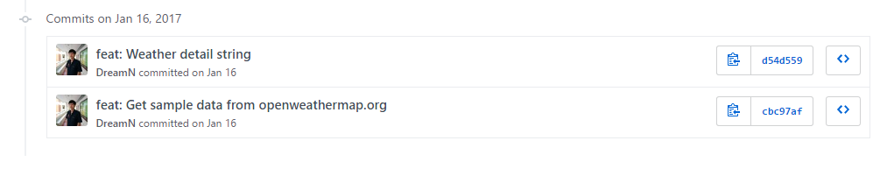
We’re practice so hard!
Over 80+ commits on github

Slide 15
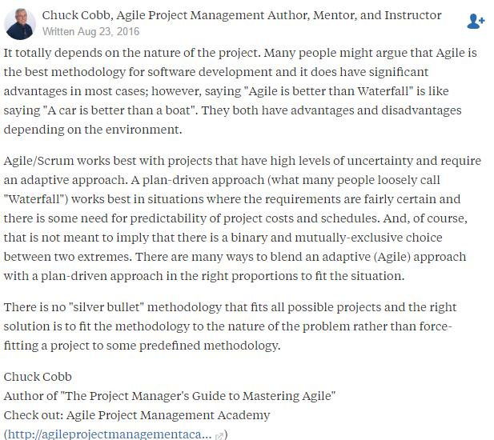

Slide 16
Trello

Slide 17
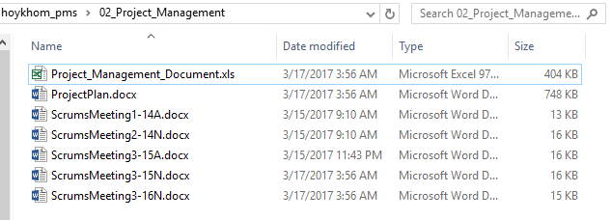
We talk 2 times a days

Slide 18
But we haven’t done yet…

Slide 19
Problem Analysis

Slide 20
Why STM32?

Slide 21
Why Raspberry Pi 3 ?

Slide 22
Why Matlab?

Slide 23
Why Heroku, Flask and psql?

Slide 24
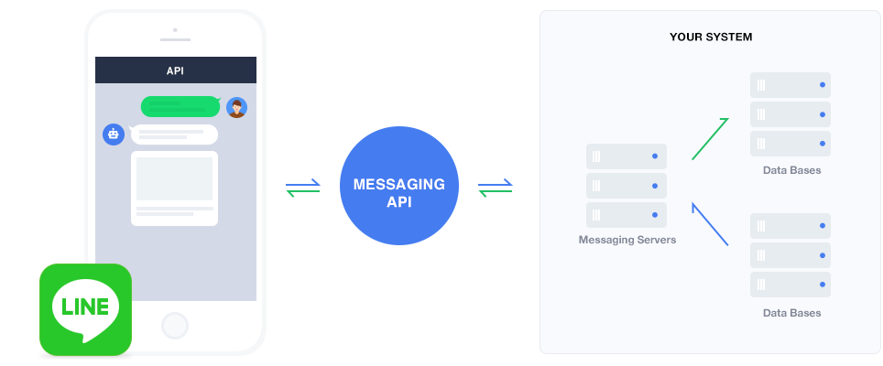
Why Line Bot API?

Slide 25
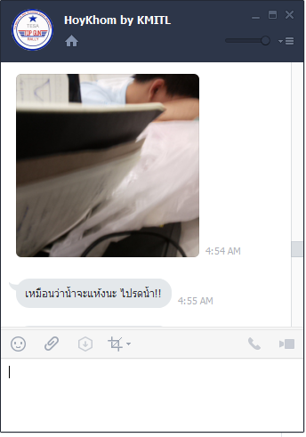
Why not just a web?

Slide 26
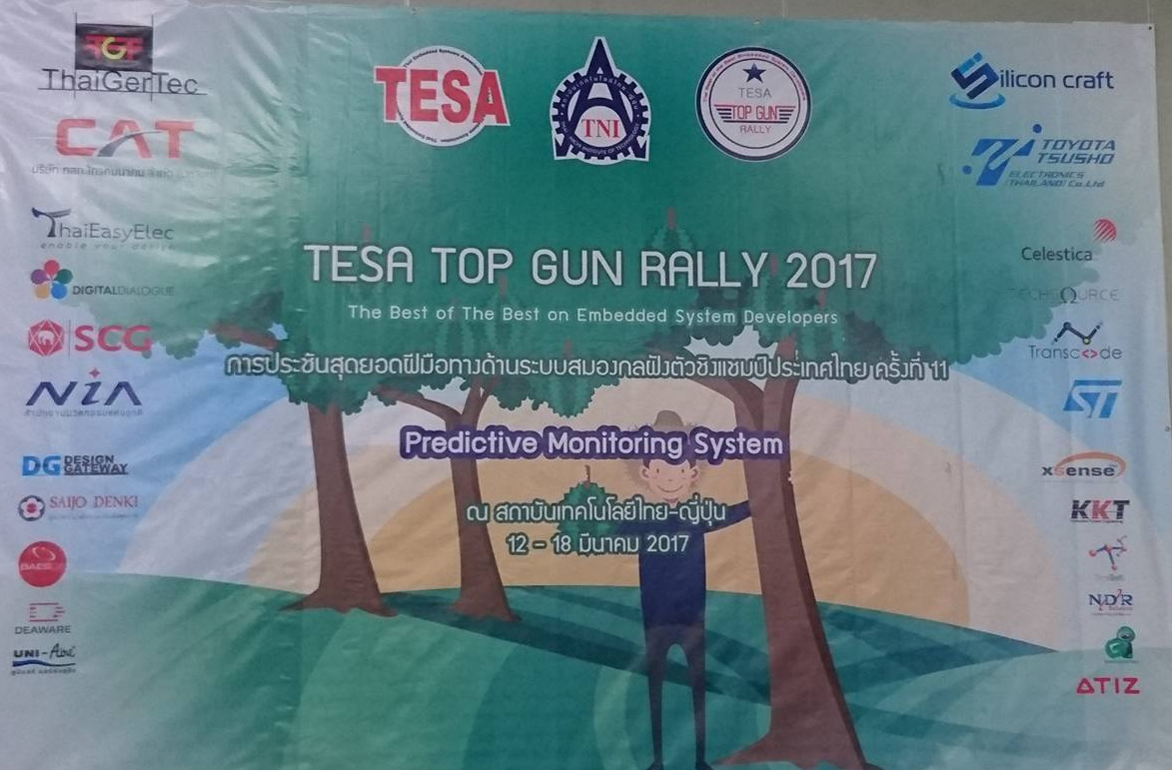
Thank You

